Slide 1

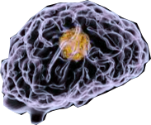
KALLAM HARANADHAREDDY INSTITUTE OF TECHNOLOGY
(AUTONOMOUS)
A Novel Method of Classification of Tumor using CNN
Guide: | By Batch – B2
Mr. Y. Murali Krishna | R. Mohith Venkata Sai | – 188X1A0479
Associate Professor | T. Satya Nandan | – 188X1A0498
 | P. Rohitha | – 188X1A0475
 | B. Pavan Bhargav | – 188X1A0474
 | Ch. Chiranjeevi | – 188X1A0461
1

Slide 2

Contents
Abstract
Introduction
Brain Tumor
Existing System
Proposed System
Expected Results
References
2

Slide 3
Brain tumor detection and classification is that the most troublesome and tedious task within the space of medicative image getting ready. MRI (Magnetic Resonance Imaging) may be a medicative procedure, typically adopted by the medical specialist for illustration of inner structure of the build with no surgery. Magnetic resonance imaging provides long information concerning the human delicate tissue, that helps within the conclusion of brain tumor. Precise segmentation of magnetic resonance imaging image is basic for the conclusion of brain tumor by laptop supported clinical device. This paper is concentrated towards the look of Associate in Nursing best and additional correct approach for the detection of neoplasm from brain magnetic resonance imaging scans and if it confirms the presence of tumor then it's focused on evaluating its stage, i.e., benign or malignant, And also Classifies the tumor type. We’ve through an experiment shown that our projected methodology features a larger accuracy than different existent strategies for classifying tumor kind. MRI scan images of the brain. This method incorporates with, segmentation and morphological operations which are the basic concepts of image processing. Detection and extraction of tumor from MRI scan images of the brain is done by using MATLAB software.
A
B
S
T
R
A
C
T
3

Slide 4
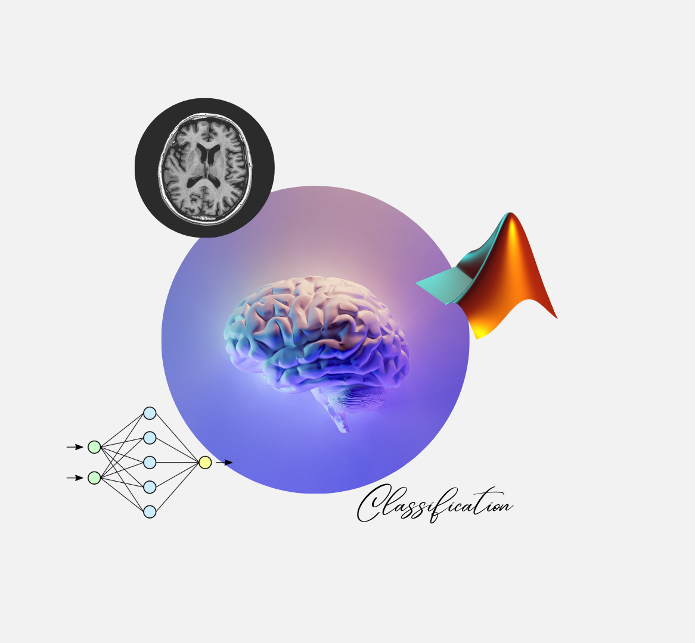
Introduction
The proposed system scans the Magnetic Resonance images of brain. The scanning is followed by preprocessing. After enhancement, the image undergoes segmentation and feature extractions. Based on the feature extraction the system identifies whether the tumor is cancerous or non - cancerous (benign) and classifies which type of tumor in three categories.
4

Slide 5
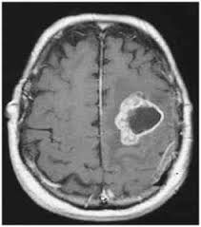
Brain Tumor
A tumor is a mass of tissue formed by the accumulation of abnormal cells, which keep on growing.
The brain Tumor can be noncancerous and cancerous.
-- Benign ☺
-- Malignant ☹
5

Slide 6
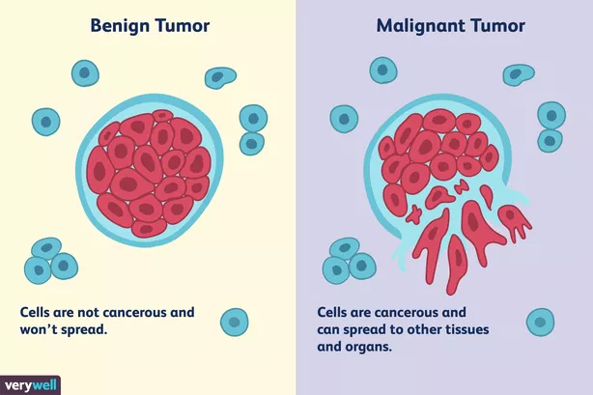
Benign and Malignant
The benign tumor is an non-cancerous tumor but coming to the malignant type tumor is an cancerous tumor
6

Slide 7
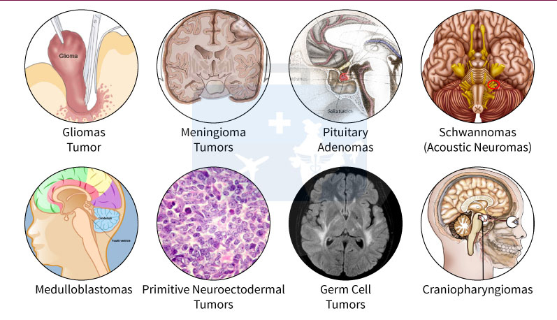
Tumor Types
These are the different types of tumors, in our system we classifies the given tumor is off which type between Glioma, Meningioma and Pituitary.
7

Slide 8
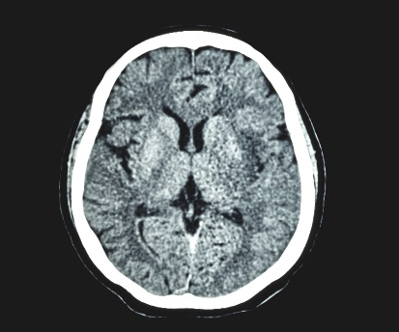
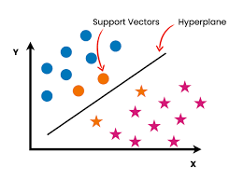
Existing System
The Existing System helps in classifying the given MRI scan consists of Tumor and says whether it was cancerous or non-cancerous
8

Slide 9
S V M
Support Vector Machine
It is used for Classification problems in Machine Learning.
Here we are using the SVM for feature extraction and classification between benign and malignant.
9

Slide 10
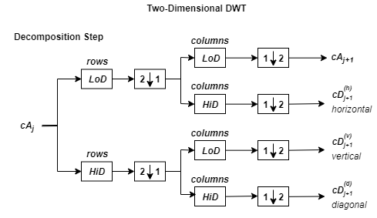
Discrete Wavelet Transformation
We are using the Single-level discrete 2-D wavelet transform (dwt2)
The input image is given to the low pass decomposition and high pass decomposition with an down sampler 2 and for each row it was again taken and gives us four parameters like approximate coefficients matrix cA and detail coefficients like cH, cV and cD (horizontal, vertical and diagonal).
10

Slide 11
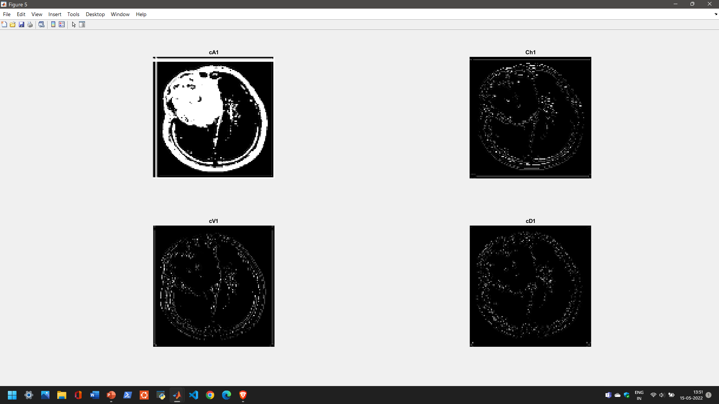
11

Slide 12
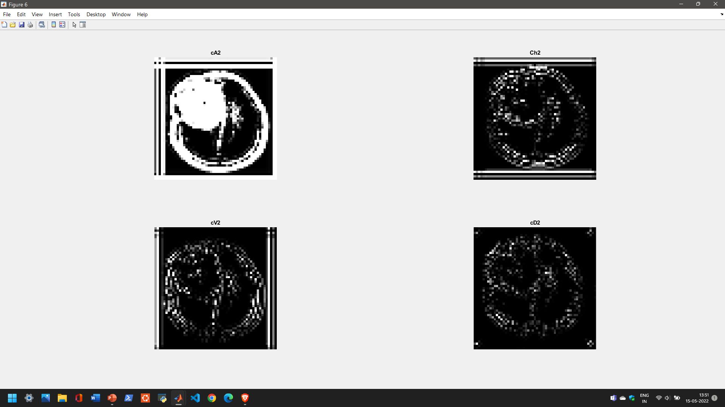
12

Slide 13
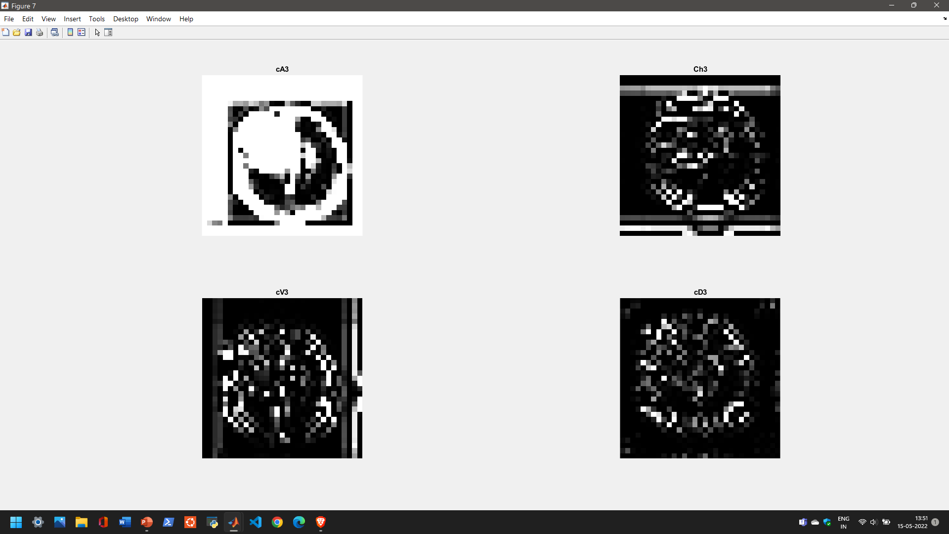
13

Slide 14
Principal component analysis
The PCA returns a principal component coefficients
It gives us an coeffient values values based on the given raw data.
The raw data is given as [cA3,cH3,cV3,cD3].
14

Slide 15
Features extraction
Gray-level co-occurrence matrix provides us an statistics of Contrast, Correlation, Energy and Homogeneity.
Stats=graycoprops(glcm,properties);
Glcm is taken gray level co matrix it can be obtained by graycomatrix.
15

Slide 16
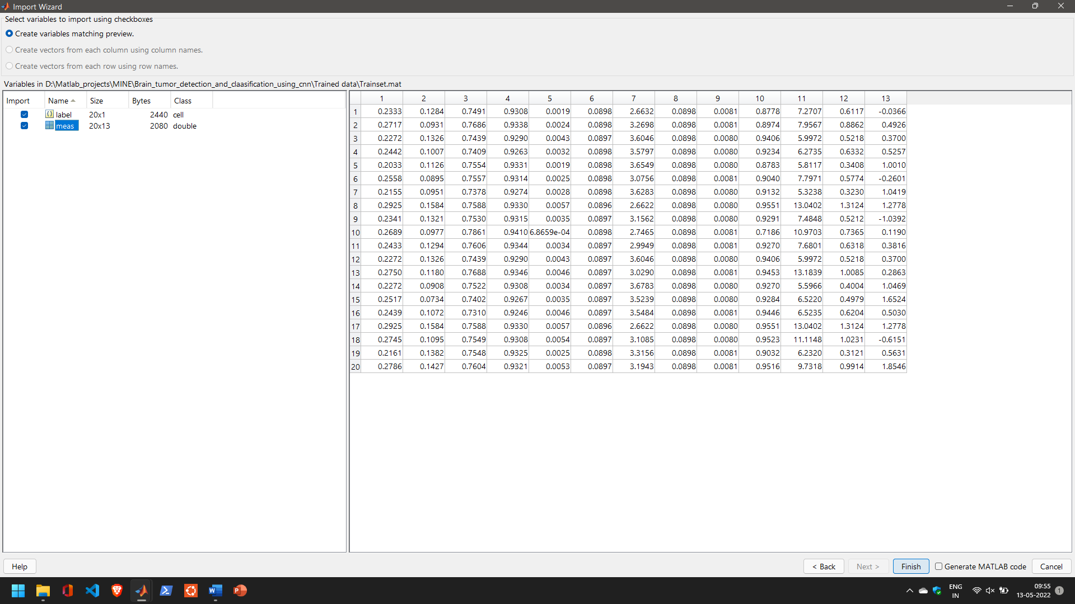
16

Slide 17
Classification
The extracted features are passed to the Support Vectors Machines and based the trained data the machine classifies the tumor is benign or malignant.
17

Slide 18
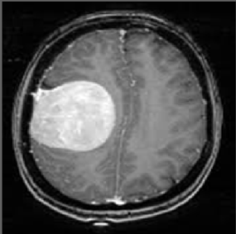
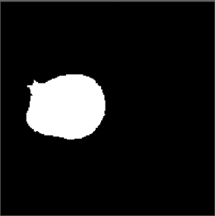
Displaying Tumor Shape
The tumor is extracted from the input MRI scan image by using the Thresholding Segmentation.
The technique we are using is Otsu’s Method.
18

Slide 19
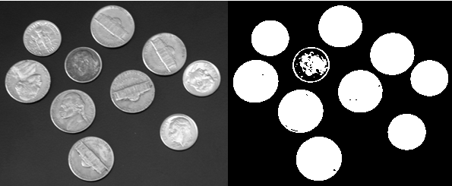
Otsu’s Method
Considering the threshold level and binarizing the image.
19

Slide 20
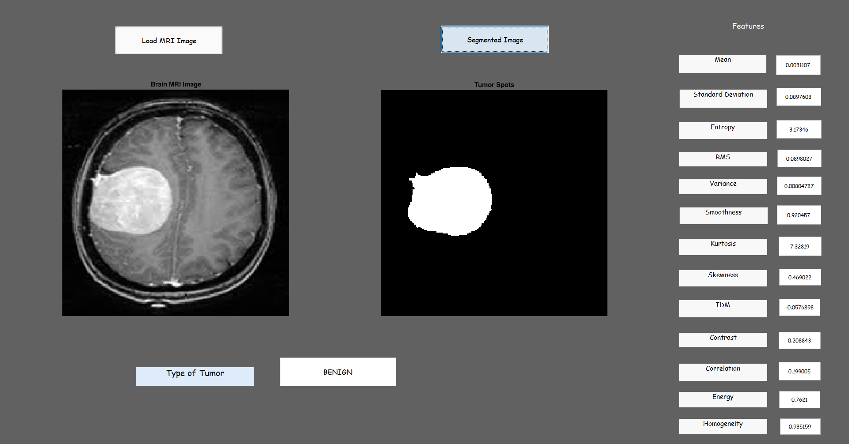
R
E
S
U
L
T
E
X
I
S
T
I
N
G
20

Slide 21
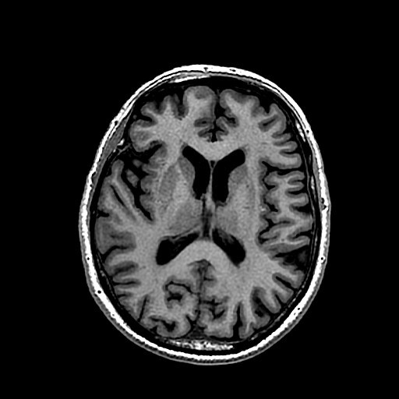
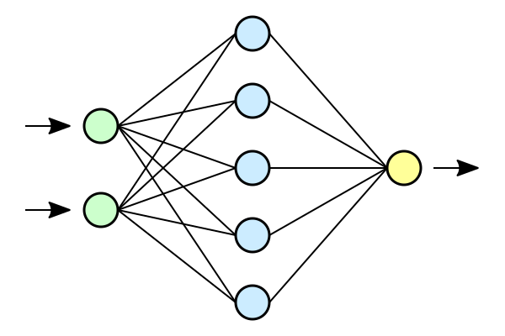
Proposed System
We are using input as MRI scan images.
Providing the tumor type.
And also highlighting the tumor.
CNN

Slide 22
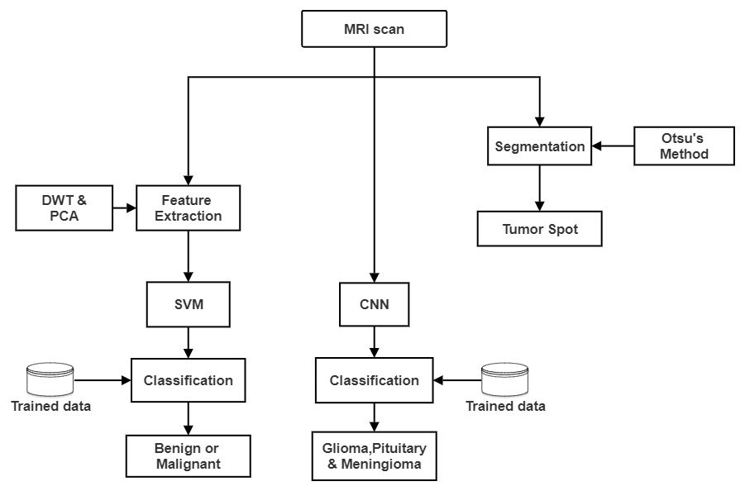
Architecture

Slide 23
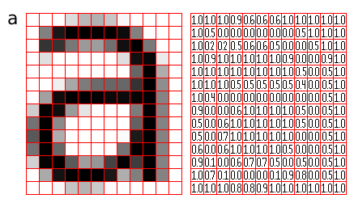
CNN
Convolutional Neural Network
It is a class of neural networks that specializes in processing data that has a grid-like topology, such as an image.
23

Slide 24

Architecture of CNN
A CNN typically has three layers: a convolutional layer, a pooling layer, and a fully connected layer.
24

Slide 25
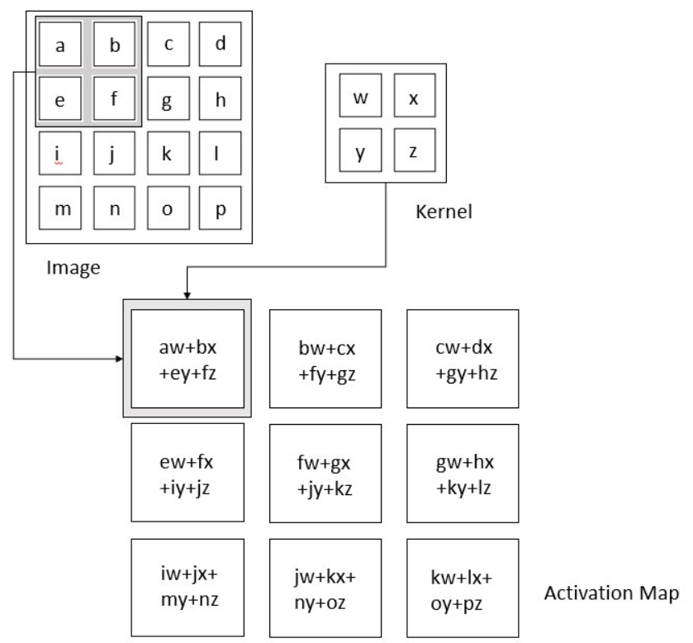
Convolution Layer
The convolution layer is the core building block of the CNN.
This layer performs a dot product between two matrices, where one matrix is the set of learnable parameters otherwise known as a kernel, and the other matrix is the restricted portion of the receptive field. The kernel is spatially smaller than an image but is more in-depth.
25

Slide 26
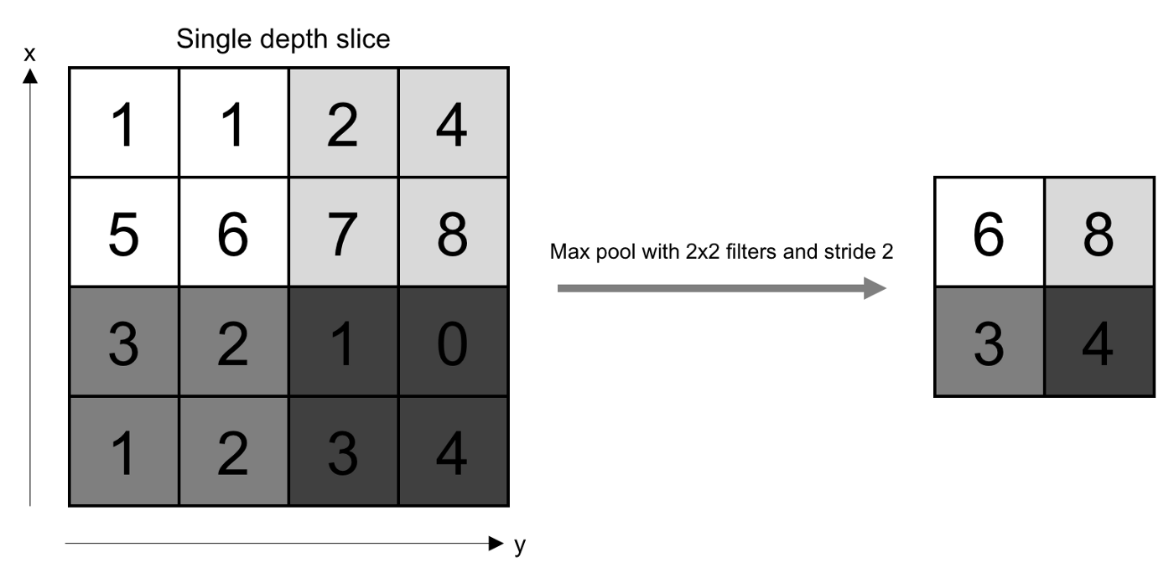
Pooling Layer
Here we are using max pooling concept.
26

Slide 27
Flattening the Images
1
2
3
4
5
6
7
8
9
Converting the Multi dimensional to one dimensional.
In this layer the images or extracted features data from hidden layers to pass it to the fully connected layer for classification the data is flattened
1 | 2 | 3
4 | 5 | 6
7 | 8 | 9
27

Slide 28
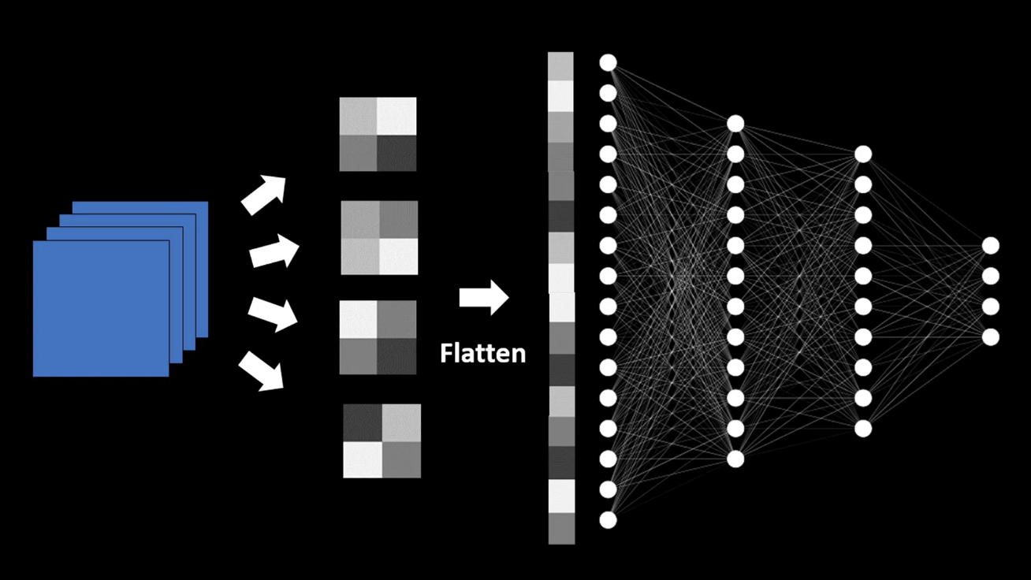
Fully Connected Layer
Neurons in this layer have full connectivity with all neurons in the preceding and succeeding layer.
The last FCL the no of nodes is matched with the no of classes we are classifying to and this is done by SoftMax method.
28

Slide 29
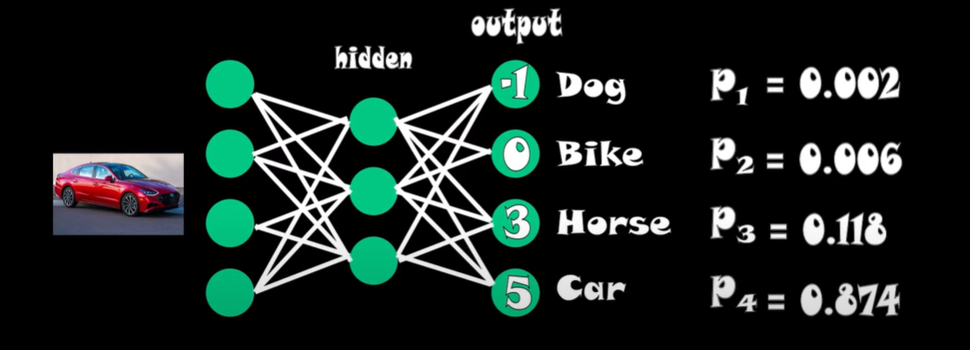
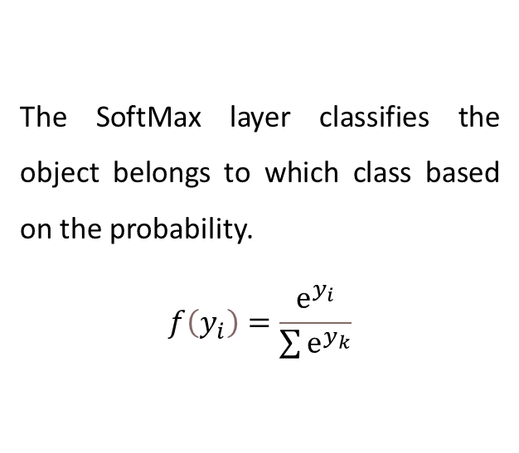
SoftMax
The SoftMax layer classifies the object belongs to which class based on the probability.
$$f\left(y_{i}\right)=\frac{ⅇ^{y_{i}}}{\sum{ⅇ^{y_{k}}}}$$
29

Slide 30
Advantages of CNN over SVM
CNN is more better for image recognition.
CNN can go through the huge amount of data than SVM and classify the data.
No need of external feature extraction of the object to be classified as like in SVM.
30

Slide 31
Transfer Learning
It is the reuse of the pre-trained model to a new problem
Here we are using the Google Net for Transfer learning.
31

Slide 32
Google Net
GoogLeNet is a 22-layer deep convolutional neural network that’s a variant of the Inception Network, a Deep Convolutional Neural Network developed by researchers at Google.
32

Slide 33
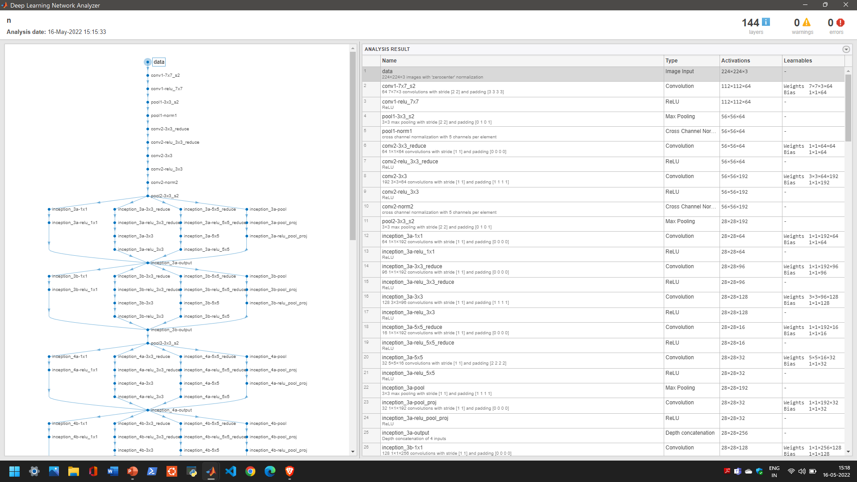
33

Slide 34
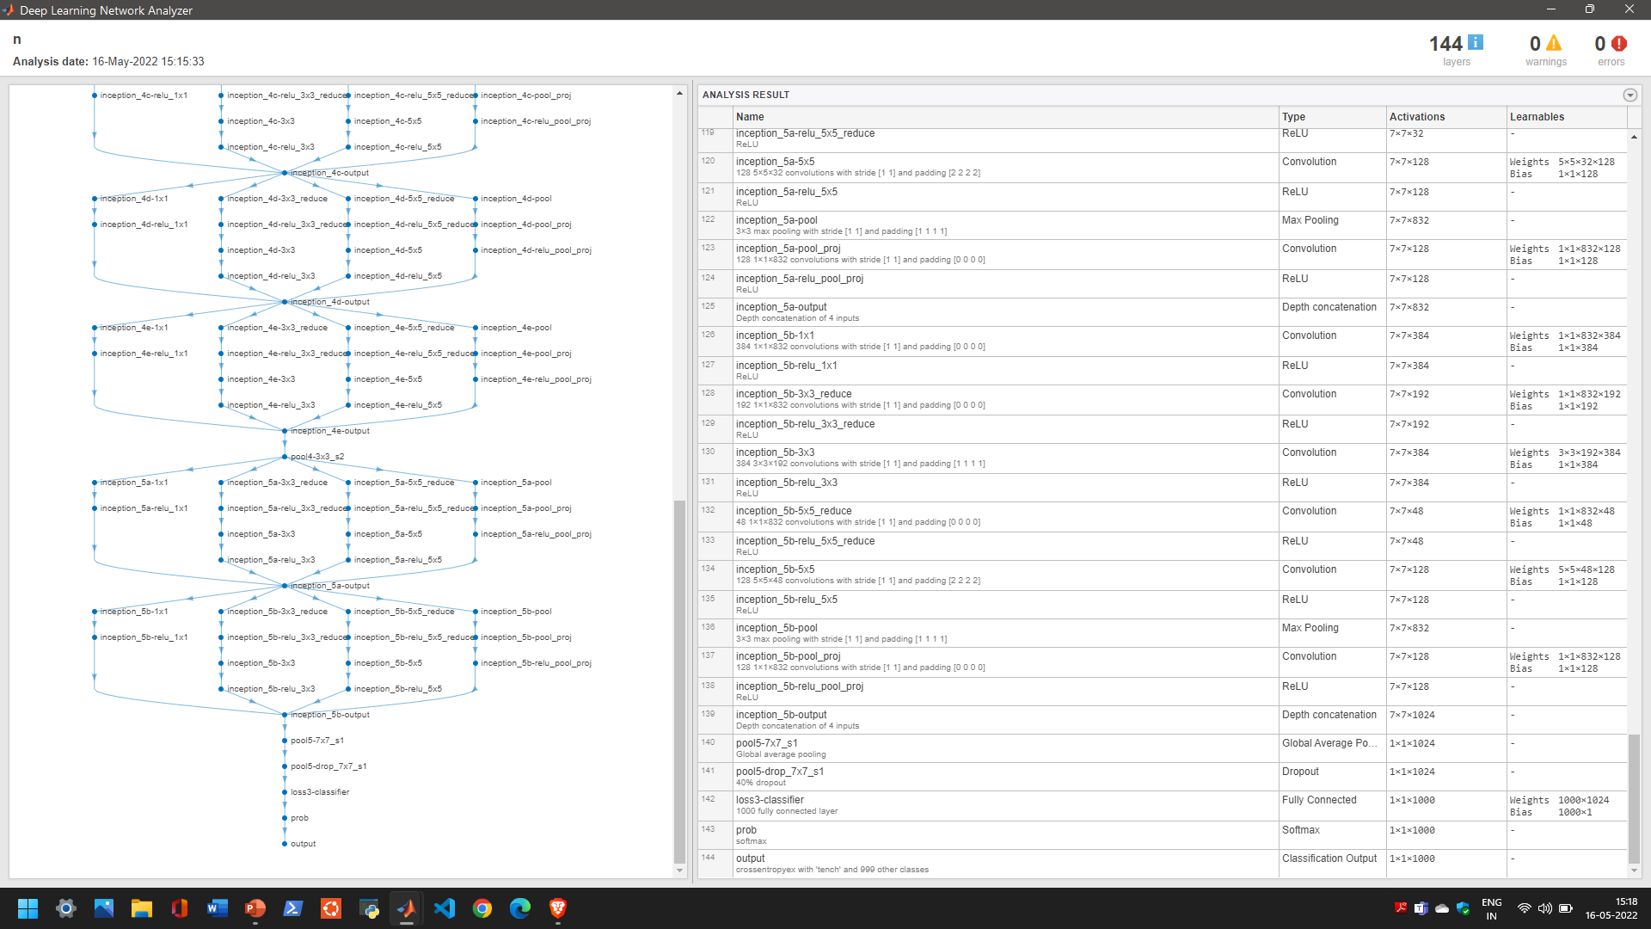
34

Slide 35
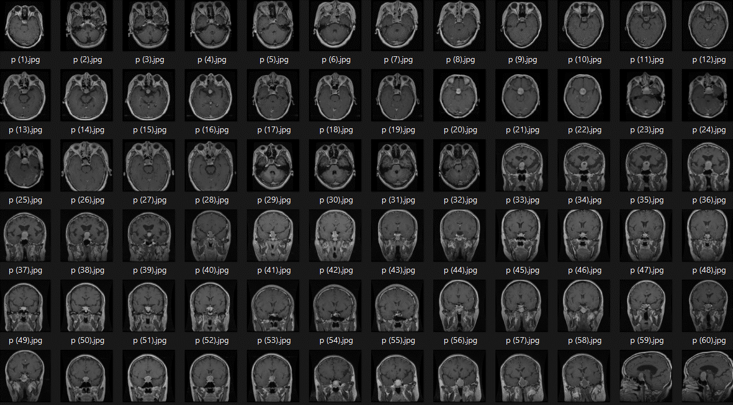
Data used for Training the Network
35

Slide 36
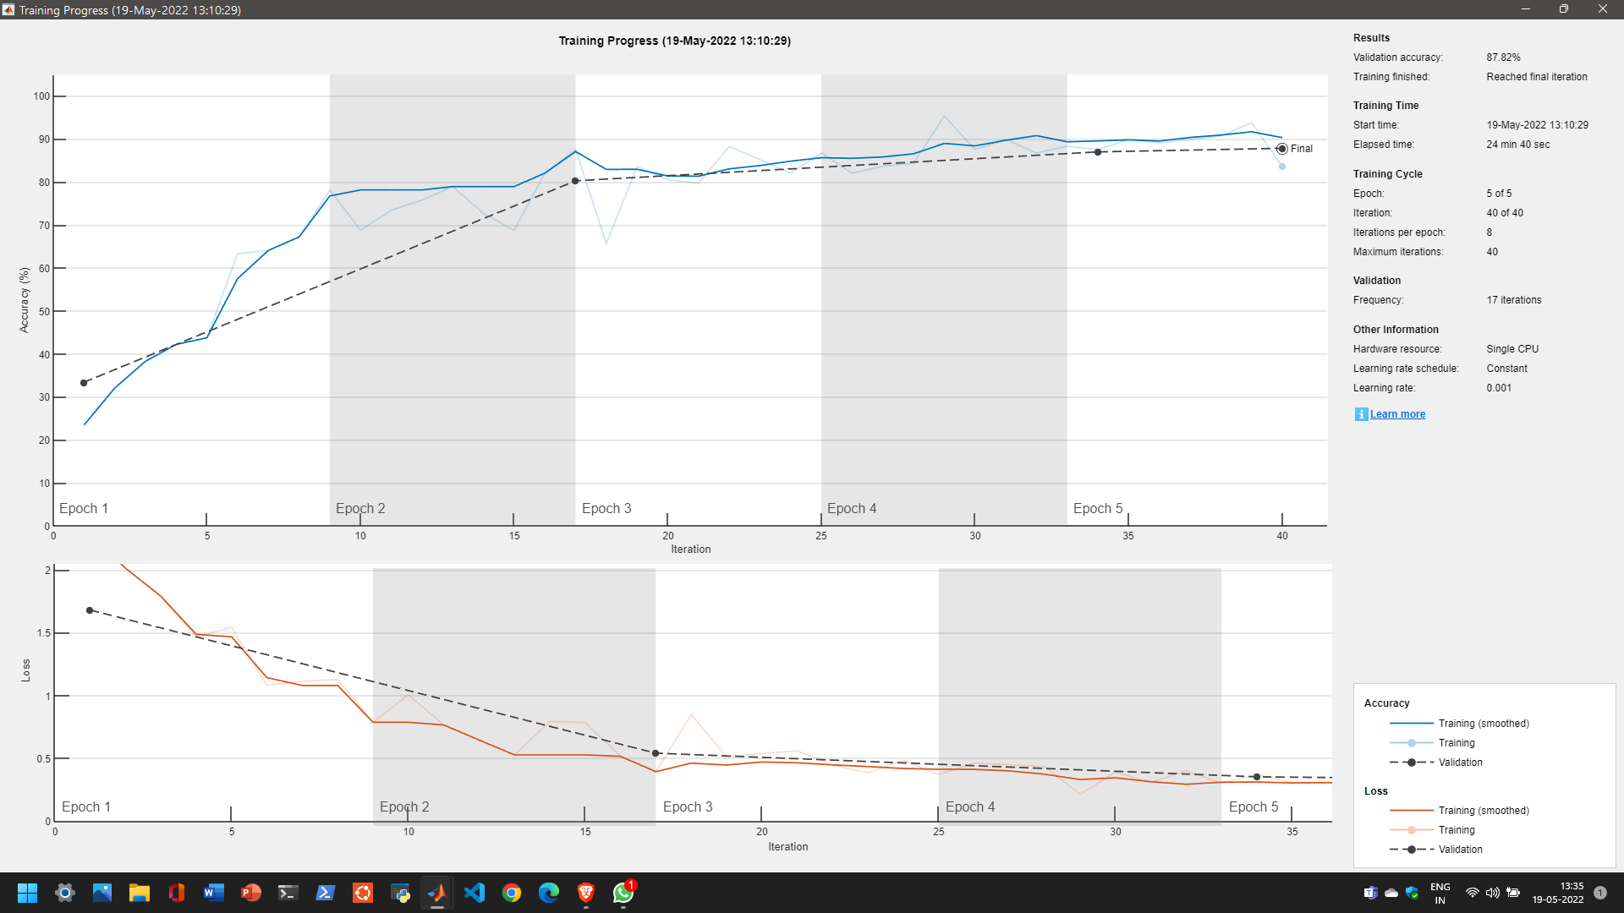
36

Slide 37
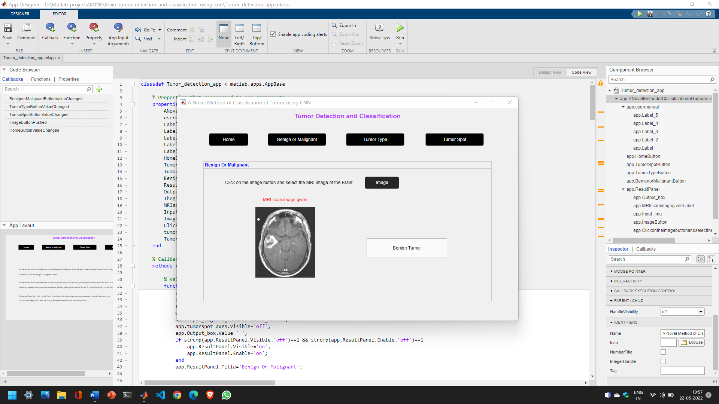
37

Slide 38
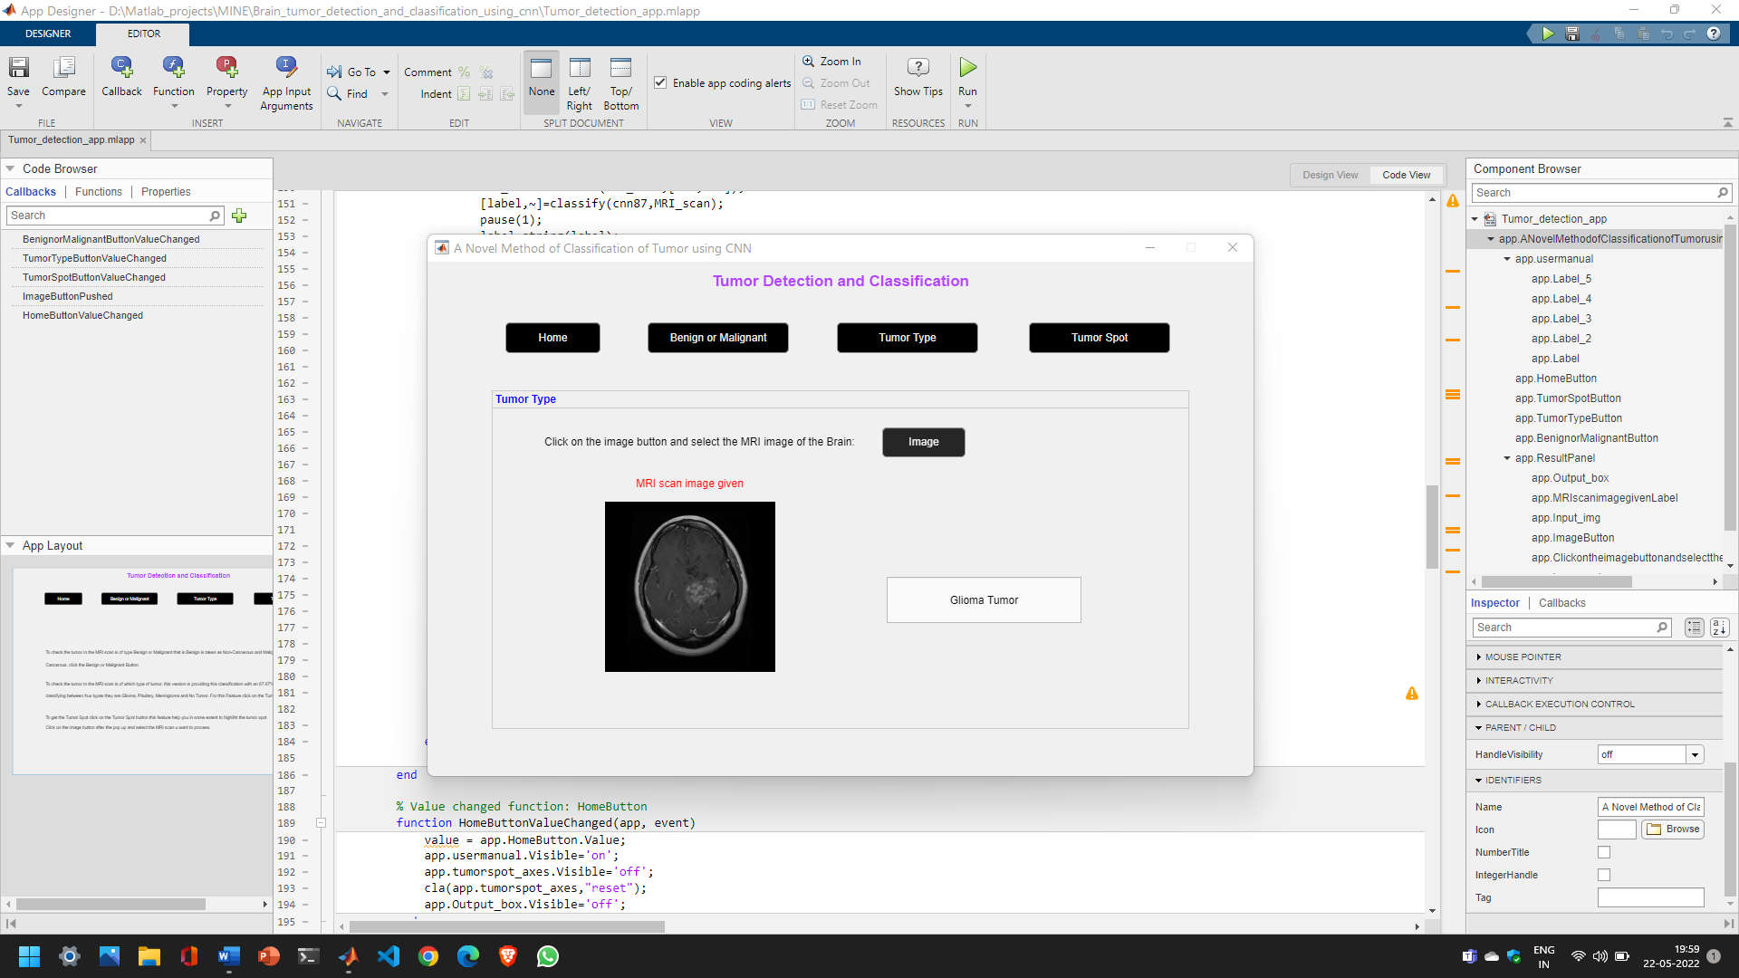
38

Slide 39
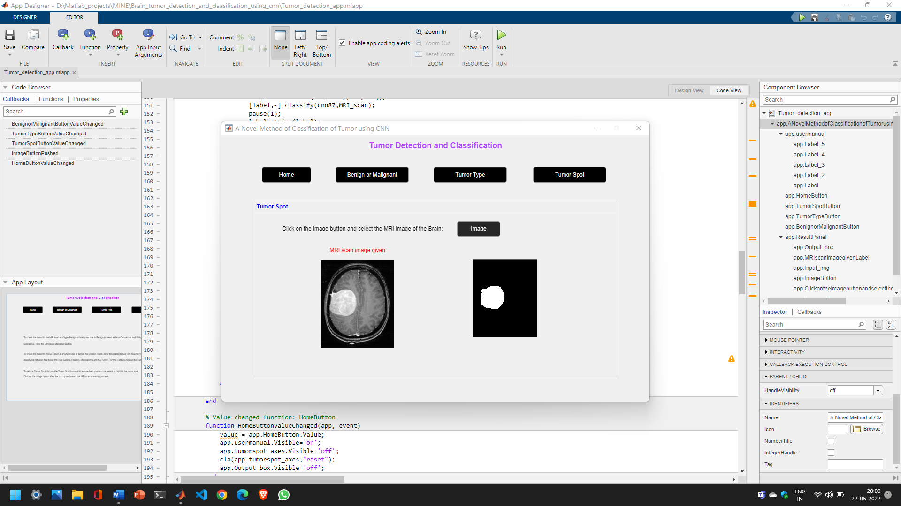
39

Slide 40
Benign or Malignant
%Binary conversion
img2 = im2bw(MRI_scan);
signal1 = img2(:,:);
%discrete wavelet transform
[cA1,cH1,cV1,cD1] = dwt2(signal1,'db4');
[cA2,cH2,cV2,cD2] = dwt2(cA1,'db4');
[cA3,cH3,cV3,cD3] = dwt2(cA2,'db4');
DWT_feat = [cA3,cH3,cV3,cD3];
G = pca(DWT_feat);
%extracting features
g = graycomatrix(G);
stats = graycoprops(g,'Contrast Correlation Energy Homogeneity');
Contrast = stats.Contrast;
Correlation = stats.Correlation;
Energy = stats.Energy;
Homogeneity = stats.Homogeneity;
Mean = mean2(G);
Standard_Deviation = std2(G);
Entropy = entropy(G);
RMS = mean2(rms(G));
Variance = mean2(var(double(G)));
a = sum(double(G(:)));
Smoothness = 1-(1/(1+a));
Kurtosis = kurtosis(double(G(:)));
Skewness = skewness(double(G(:)));
feat = [Contrast,Correlation,Energy,Homogeneity, Mean, Standard_Deviation, Entropy, RMS, Variance, Smoothness, Kurtosis, Skewness, IDM];
%loading the data trained to the workspace
load 'Trained data'\Trainset.mat
xdata = meas;
group = label;
svmStruct1 = fitcsvm(xdata,group,'KernelFunction', 'linear');
species= predict(svmStruct1,feat);
disp(species);
40

Slide 41
Tumor Type
Tumor spot
%loading the network
load 'Trained data’\cnn87.mat
%resize the image to the input layer size
MRI_scan=imresize(MRI_scan,[224,224]);
[label,~]=classify(net,MRI_scan);
label=string(label);
I=MRI_scan;
%color space convertion
gray = rgb2gray(I);
img = im2bw(gray,.6);
img = bwareaopen(img,80);
41

Slide 42
Conclusion
We conclude that our software helps in detecting the tumor in two ways one option is it was Benign or Malignant and the second option is it can classify the given MRI scan consists of which type of Tumor based on three categories like Glioma, Pituitary and Meningioma.
42

Slide 43
Future Scope
The present system classifies the tumor only between four categories our future scope is to train the network for all the types and increase the classes for classification.
43

Slide 44
References
T. Logeswari and M. Karnan, “An improved implementation of brain tumor detection using segmentation based on hierarchical self organizing map,” Int. J. Comput. Theory Eng., vol. 2, no. 4, p. 591, 2010.
S. Pereira, A. Pinto, V. Alves, and C. A. Silva, “Brain tumor segmentation using convolutional neural networks in MRI images,” IEEE Trans. Med. Imaging, vol. 35, no. 5, pp. 1240– 1251, 2016.
H. Mohsen, E. A. El-Dahshan, E. M. El-Horbaty, and A. M. Salem, “Brain tumor type classification based on support vector machine in magnetic resonance images,” Ann. “Dunarea Jos” Univ. Galati, Math. Physics, Theor. Mech. Fascicle II, Year IX, no. 1, 2017.
J. Amin, M. Sharif, M. Yasmin, and S. L. Fernandes, “Big data analysis for brain tumor detection: Deep convolutional neural networks,” Futur. Gener. Comput. Syst., vol. 87, pp. 290–297, 2018.
K. Simonyan and A. Zisserman, “Very deep convolutional networks for large-scale image recognition,” arXiv Prepr. arXiv1409.1556, 2014.
44

Slide 45
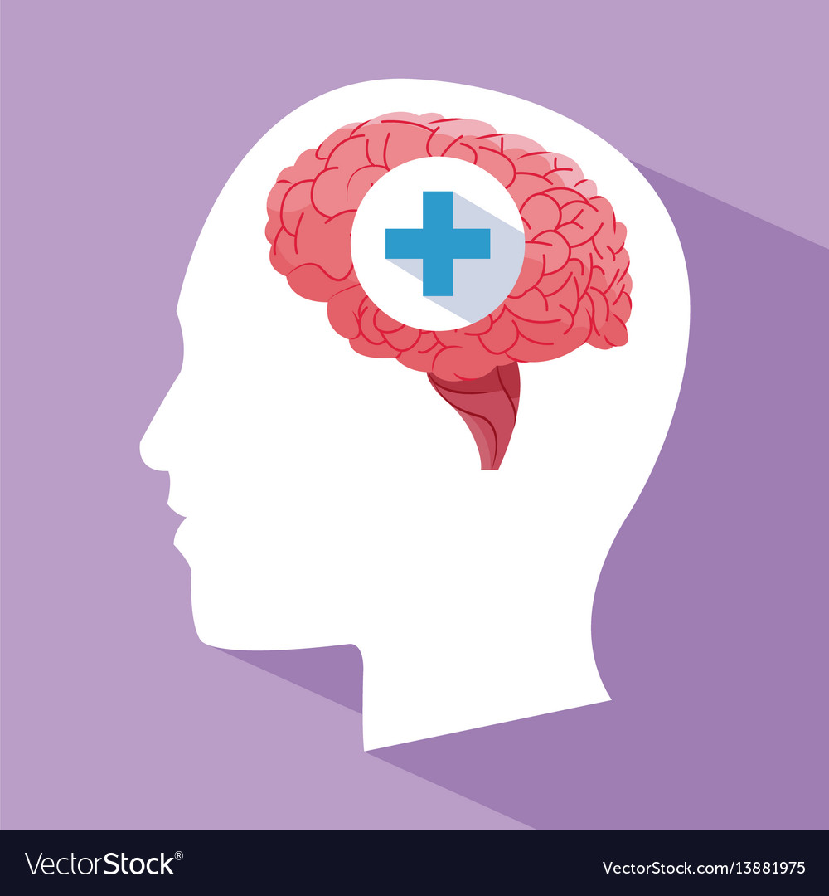
Thank You
45

